Slide 1

Teranet dataset
Modeling results
Prepared by: Stepan Oskin
Photo by Sam Kolder from Pexels

Slide 2
Section 1:
Objective

Slide 3
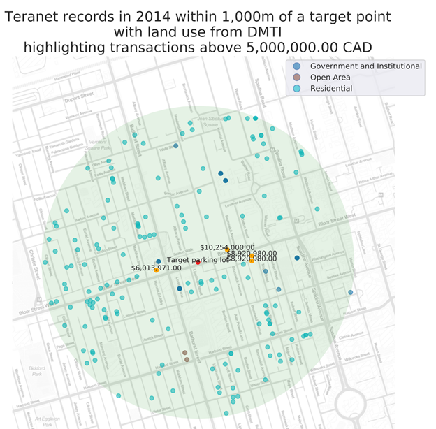
1: Objective: add land use to Teranet records
The objective of this ML workflow
is to classify land use at Teranet transaction level (recognizing changes of land use with time) from the housing market dynamics, as defined by the dataset composed from:
Features engineered from Teranet attributes
Census variables
TTS variables
(eliminated during feature selection)

Slide 4
Section 2:
Feature selection

Slide 5
2.1: Feature selection methods
A combination of the following Feature Subset Selection (FSS) have been applied:
Filters
SelectKBest from scikit-learn: univariate feature selection based on the following statistical tests:
Chi-2
ANOVA F-value between label/feature
Mutual information for a discrete target
Wrappers
SelectFromModel in scikit-learn
Recursive feature elimination: RFE in scikit-learn
Sequential feature selection: Sequential Backward Selection (SBS)
Embedded methods
L1 regularization for Logistic Regression and Linear Support Vector Classifier

Slide 6
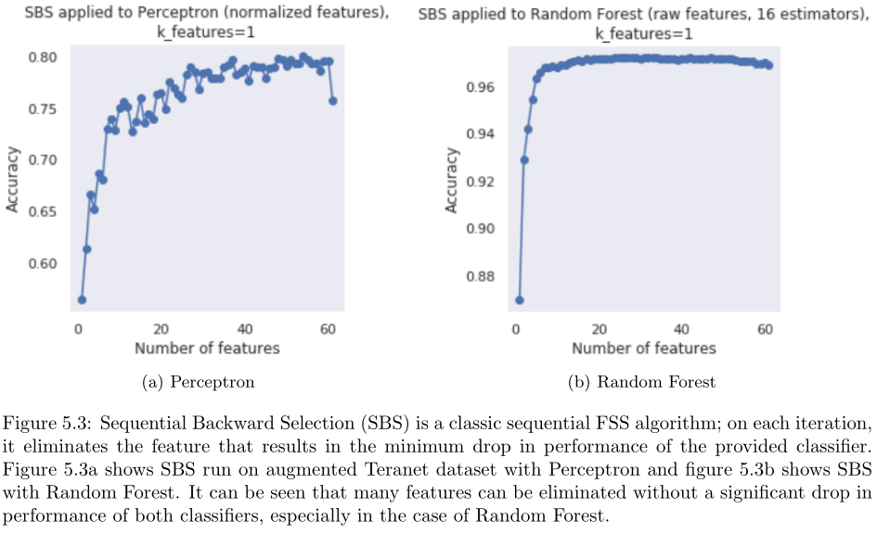
2.2: Feature selection methods, SBS

Slide 7
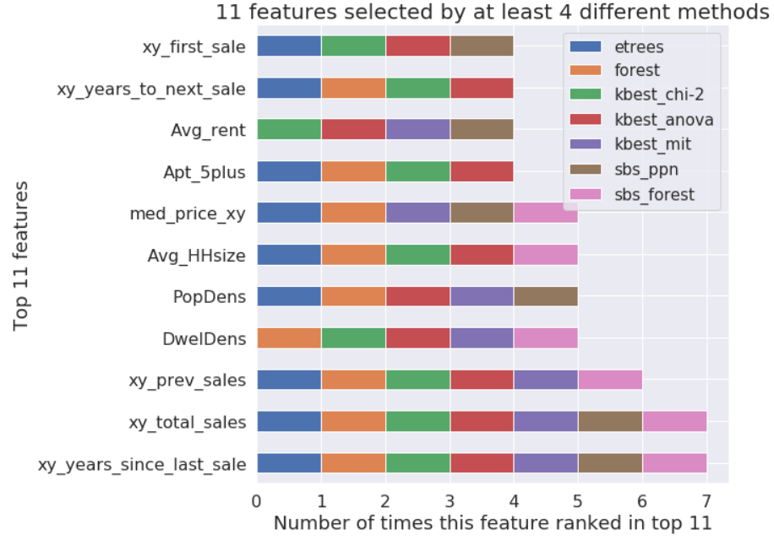
2.3: Feature selection results: 11 top features
11 features have been selected by at least 4 different feature selection algorithms

Slide 8
Section 3:
Exploratory Data Analysis (EDA)
of selected features

Slide 9
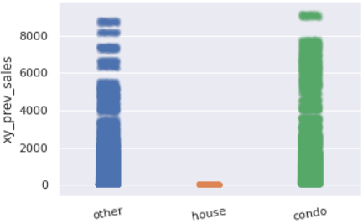
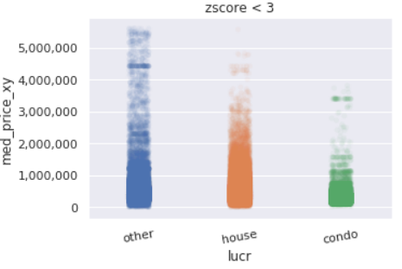
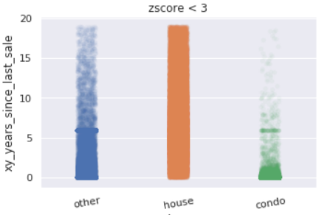
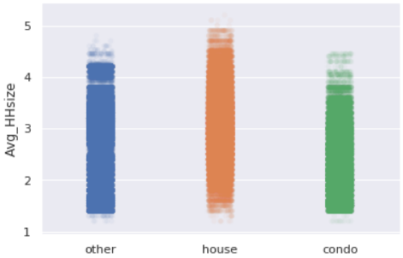
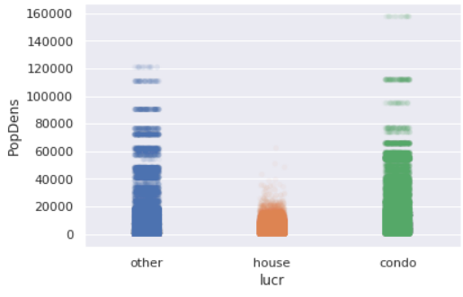
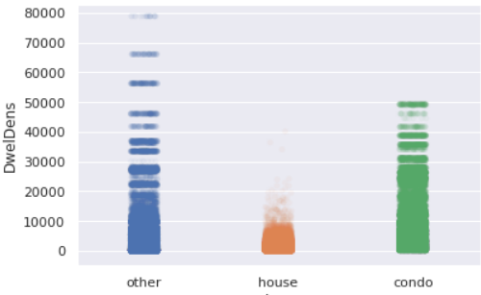
3.1: EDA, stripplots by target classes
Teranet features
Census features
Stripplots were produced for each of the 11 selected features by target classes.

Slide 10
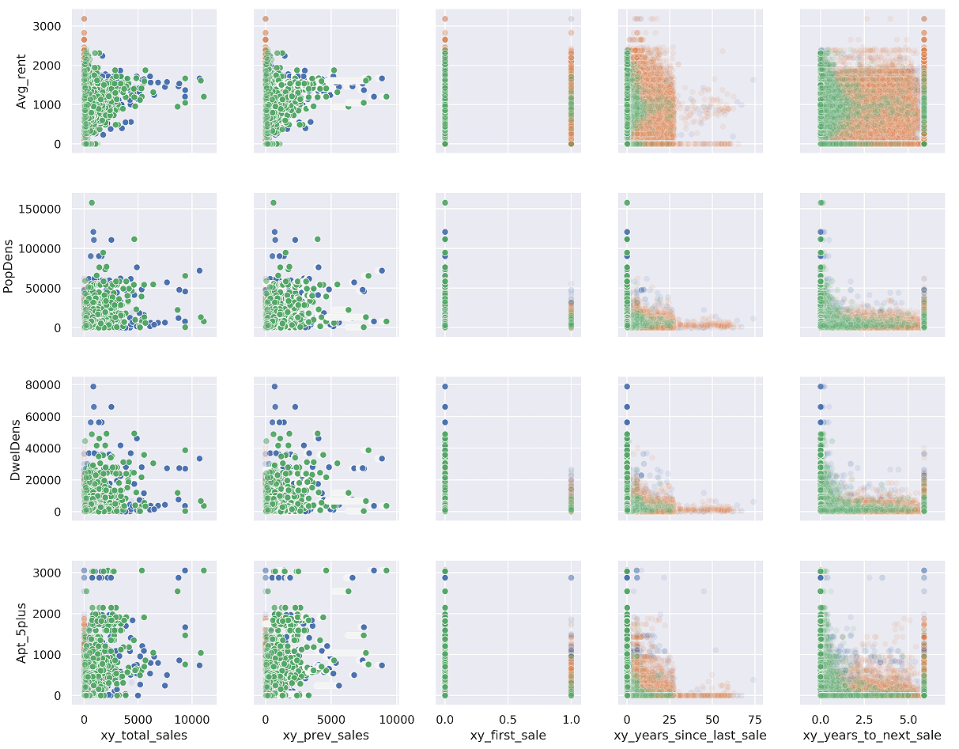
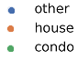
3.2: Top 11 features, pairplot
Reduced
land use
classes:
Census features
Teranet features
A section of the pairplot produced from the selected 11 top features.

Slide 11
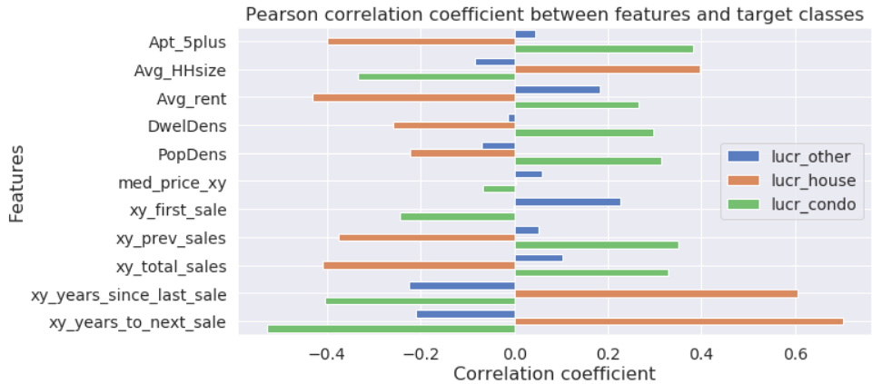
3.3: Top 11 features: correlation with target
All features have some degree of linear relationship with the target classes.

Slide 12
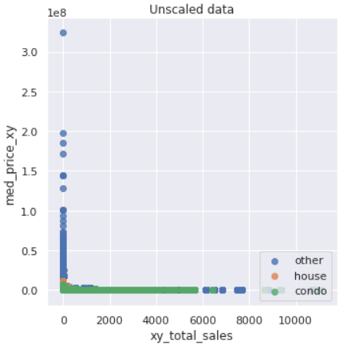
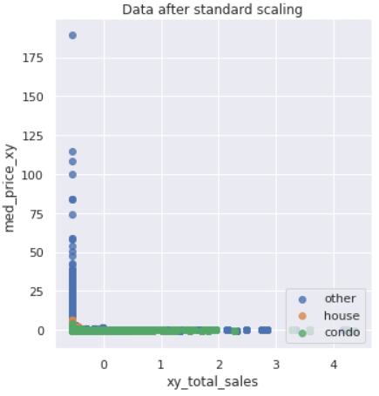
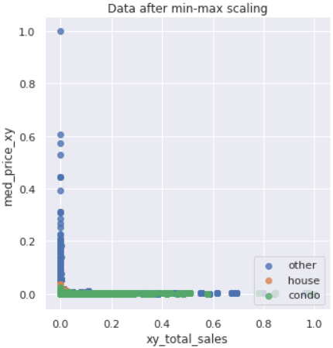
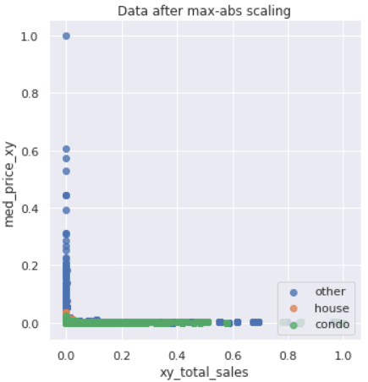
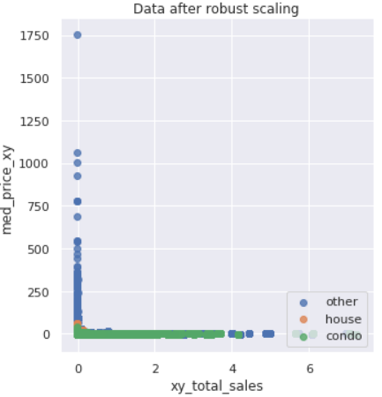
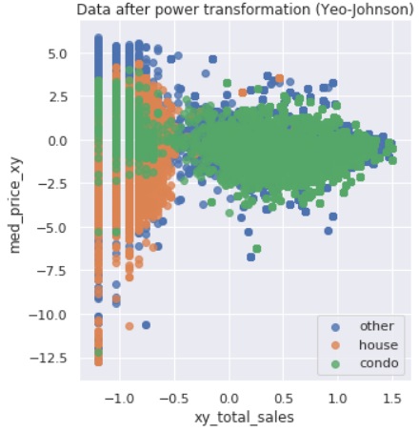
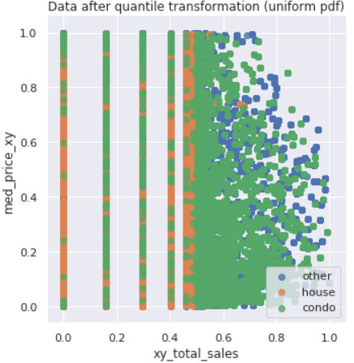
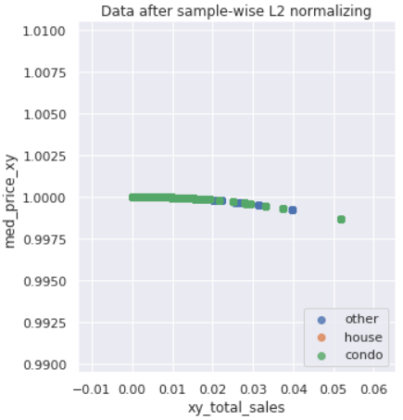
3.4: Effects of different scalers on data
Non-linear transformations
All features have some degree of linear relationship with the target classes.

Slide 13
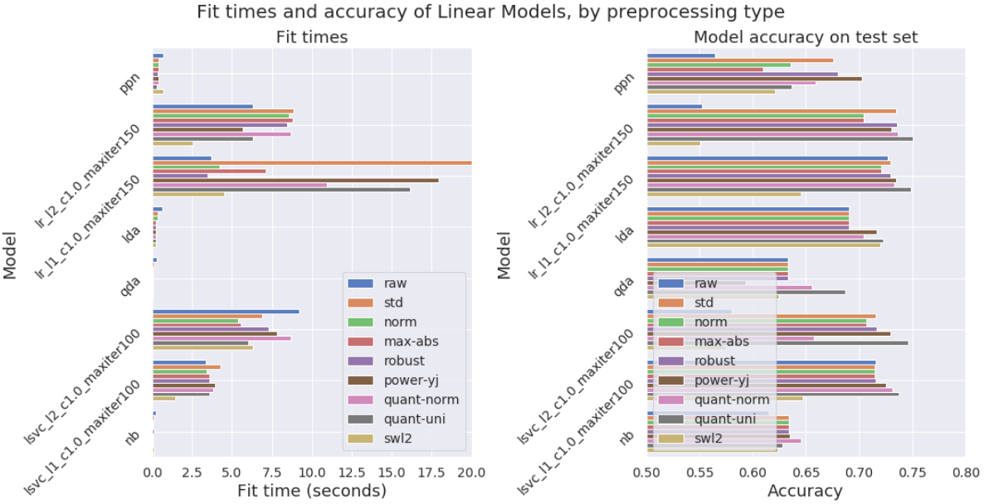
3.5: Model fit times: linear models

Slide 14
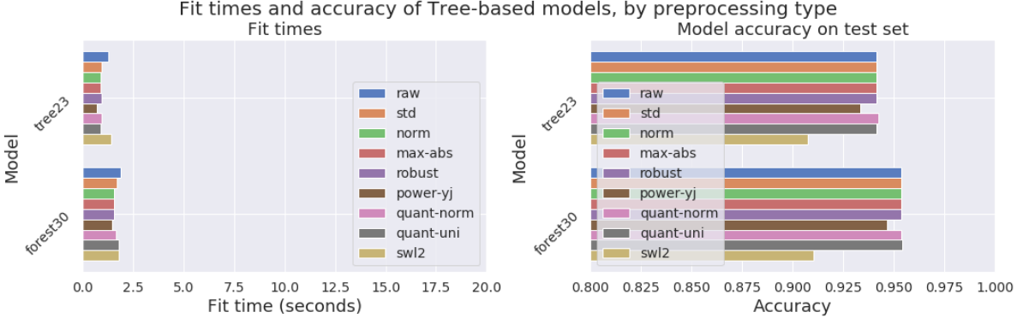
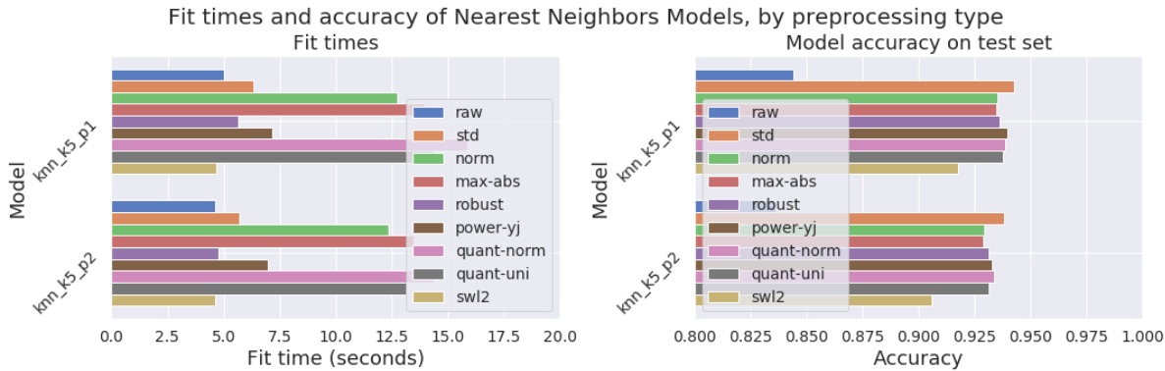
3.5: Model fit times: trees and neighbors

Slide 15
Section 4:
Model selection

Slide 16
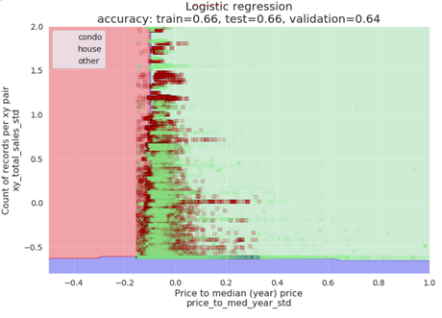
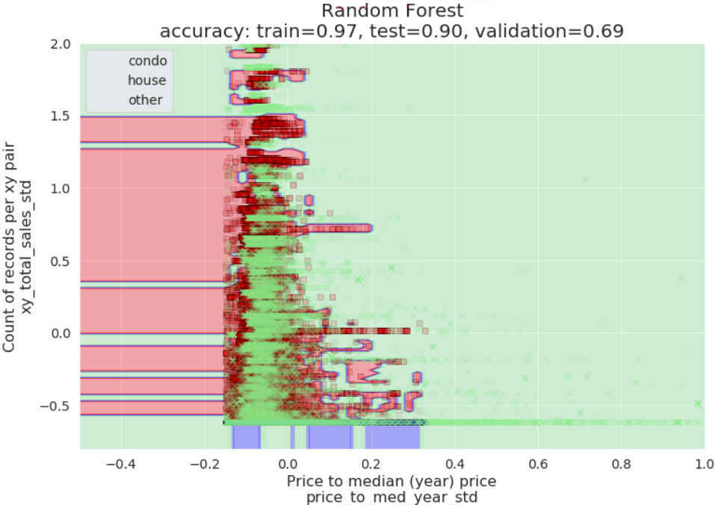
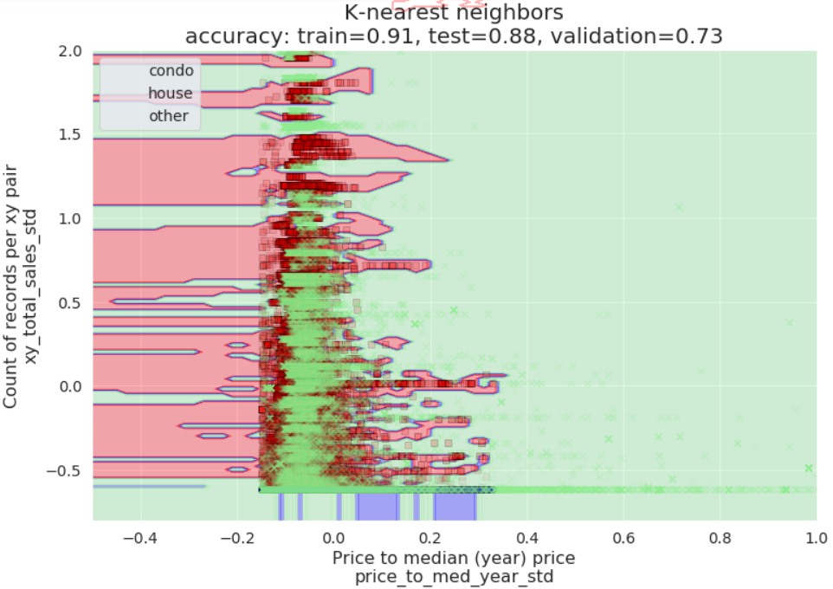
2-D decision boundaries
Linear models
Perceptron, Logistic Regression (L2, L1),
Linear Support Vector Classifier (L2, L1),
Linear Discriminant Analysis (LDA),
Quadratic Discriminant Analysis (QDA),
Tree-based models
Decision Tree, Random Forest
3. Nearest Neighbors
4.1: Types of models tested

Slide 17
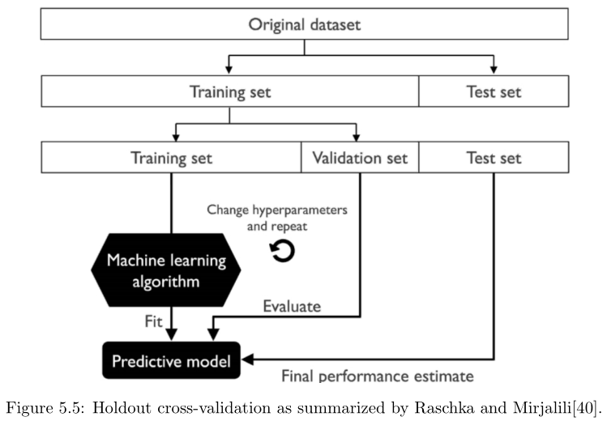
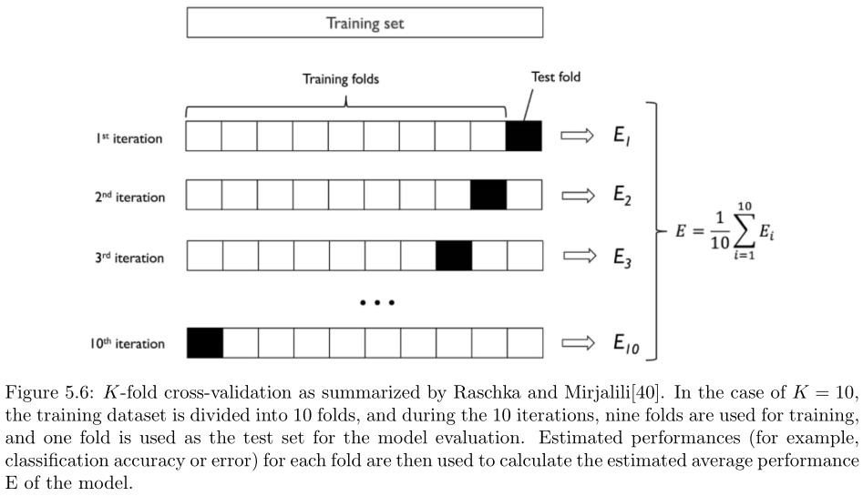
4.2: Model selection: hyperparameter tuning
K-fold cross validation was used to tune the hyperparameters
of each model via grid search

Slide 18
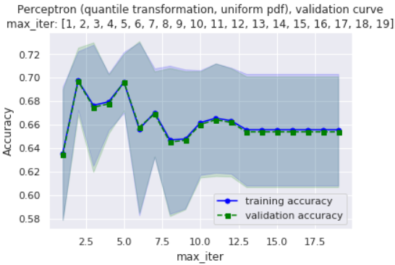
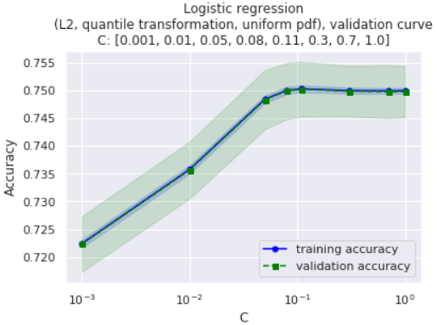
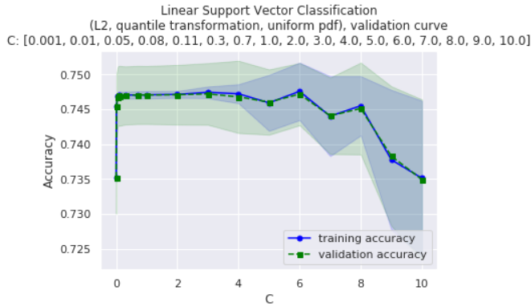
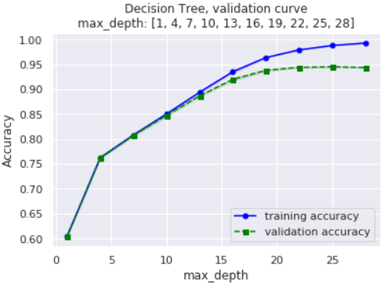
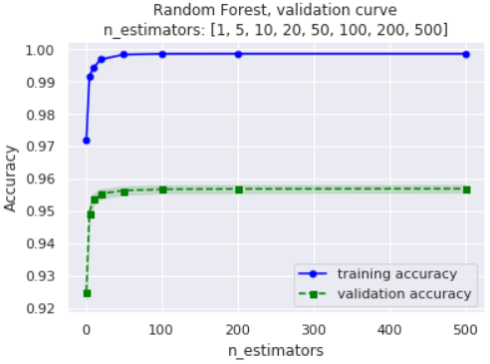
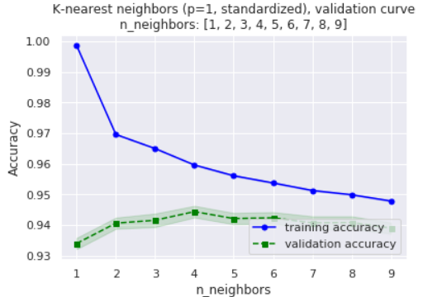
4.2: Model selection: hyperparameter tuning
Perceptron: max_iter, eta0
Logistic Regression: C, max_iter
LSVC: C, max_iter
Decision Tree: max_depth
Random Forest: n_estimators
KNN: p, n_neighbors
Validation curves show how model accuracy varies with hyperparameter values

Slide 19
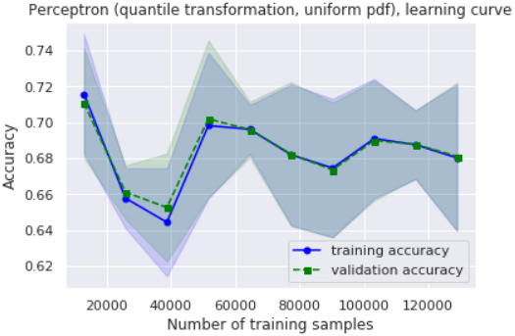
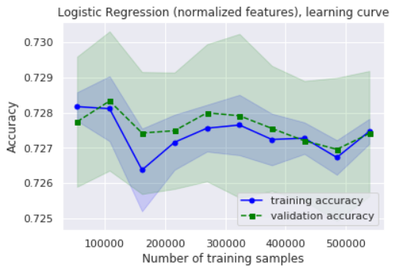
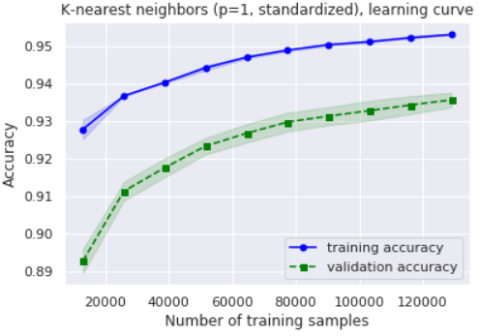
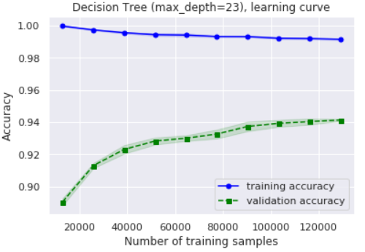
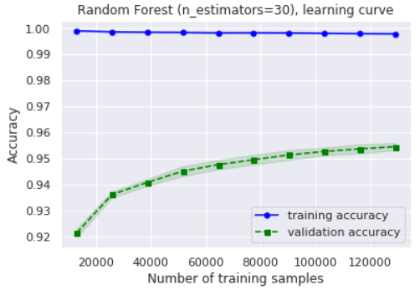
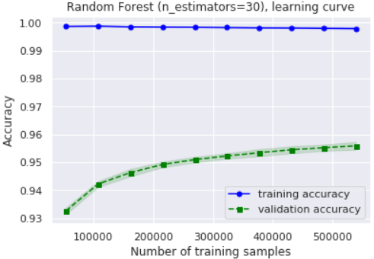
4.3: Model selection: effects of training set size
Perceptron
Logistic Regression
K-nearest neighbors
Decision Tree
Random Forest
Random Forest (more data)
Learning curves show how model accuracy changes with the size of the training set

Slide 20
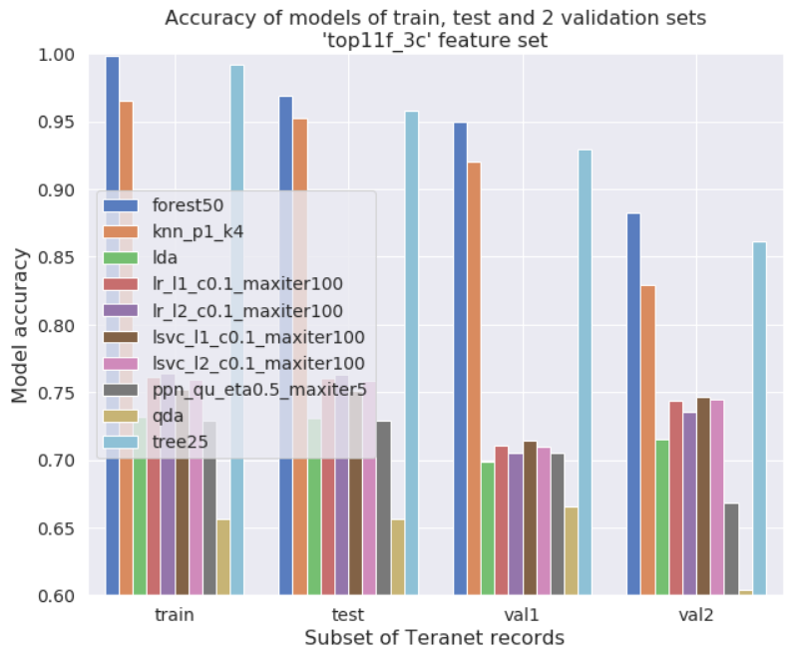
4.4: Performance of classifiers: accuracy score

Slide 21
Section 5:
Best performing model

Slide 22
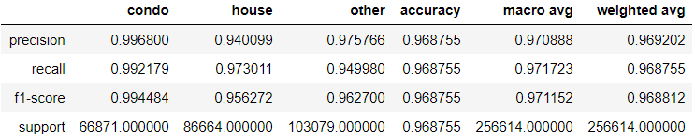
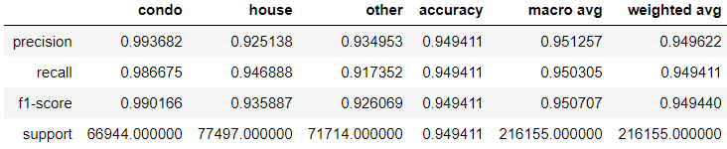
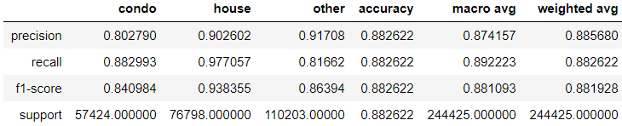
4.2: Best performing model: classification reports
Train-test subset
Extra validation subset #1
Extra validation subset #2

Slide 23
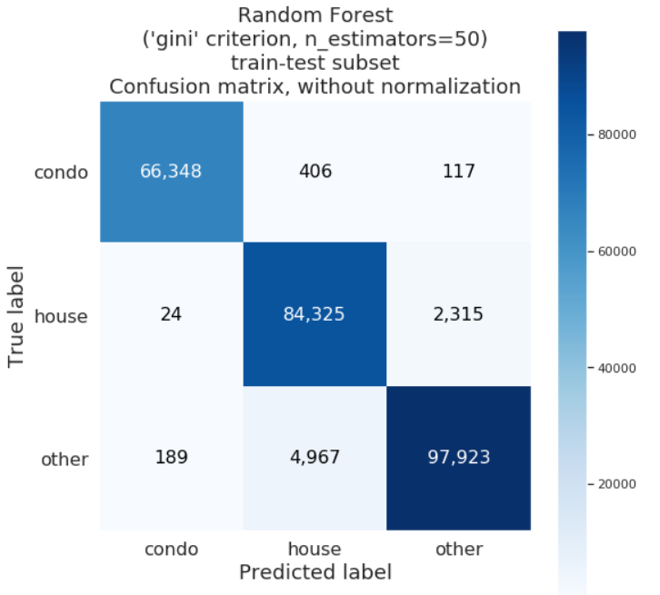
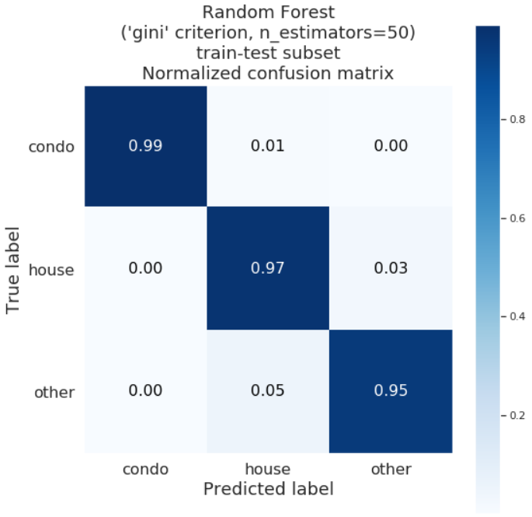
4.3: Best performing model: confusion matrices
Train-test subset

Slide 24
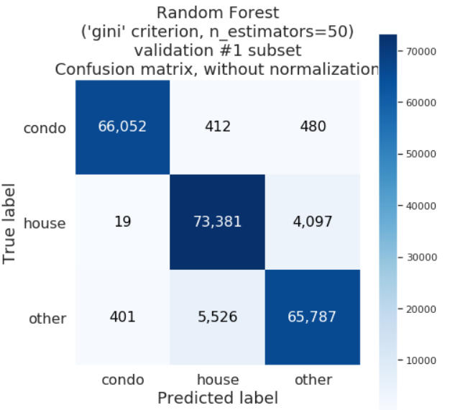
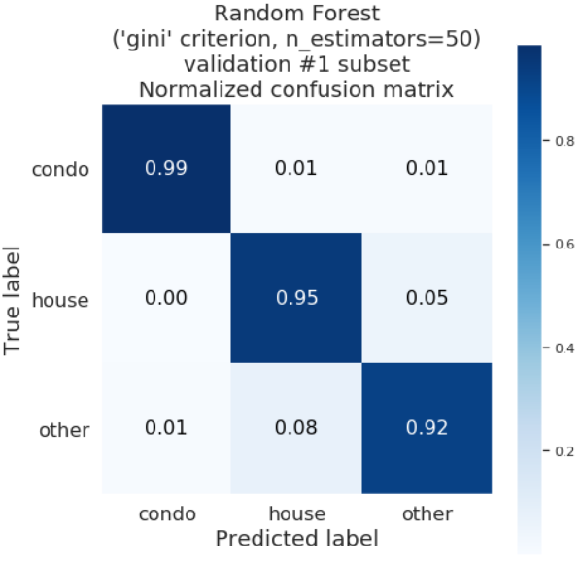
4.3: Best performing model: confusion matrices
Extra validation subset #1

Slide 25
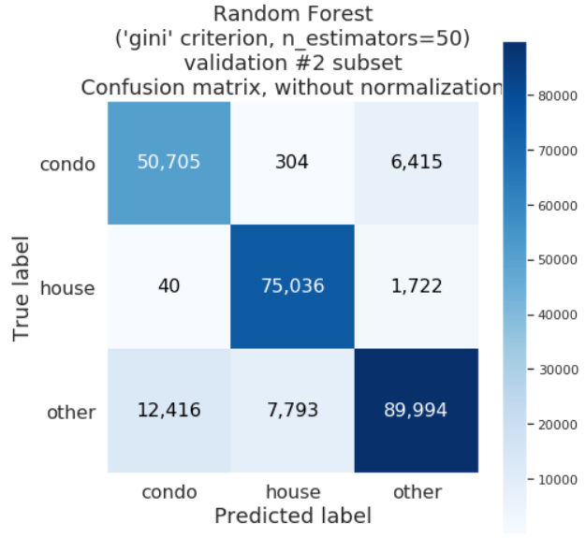
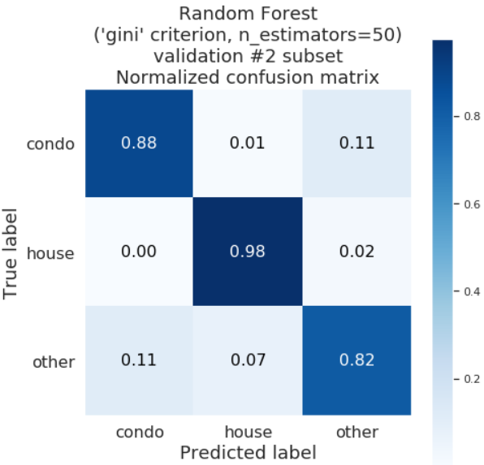
4.3: Best performing model: confusion matrices
Extra validation subset #2

Slide 26

4.4: Best performing model: feature importance

